Slide 1


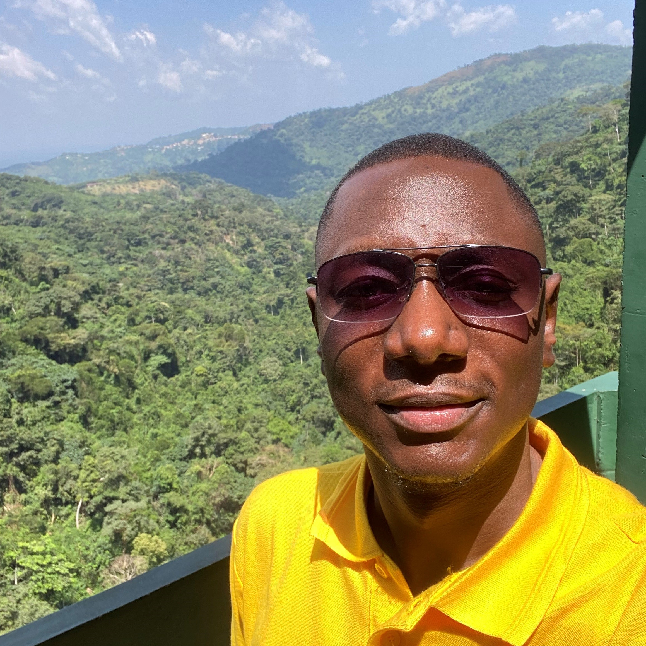

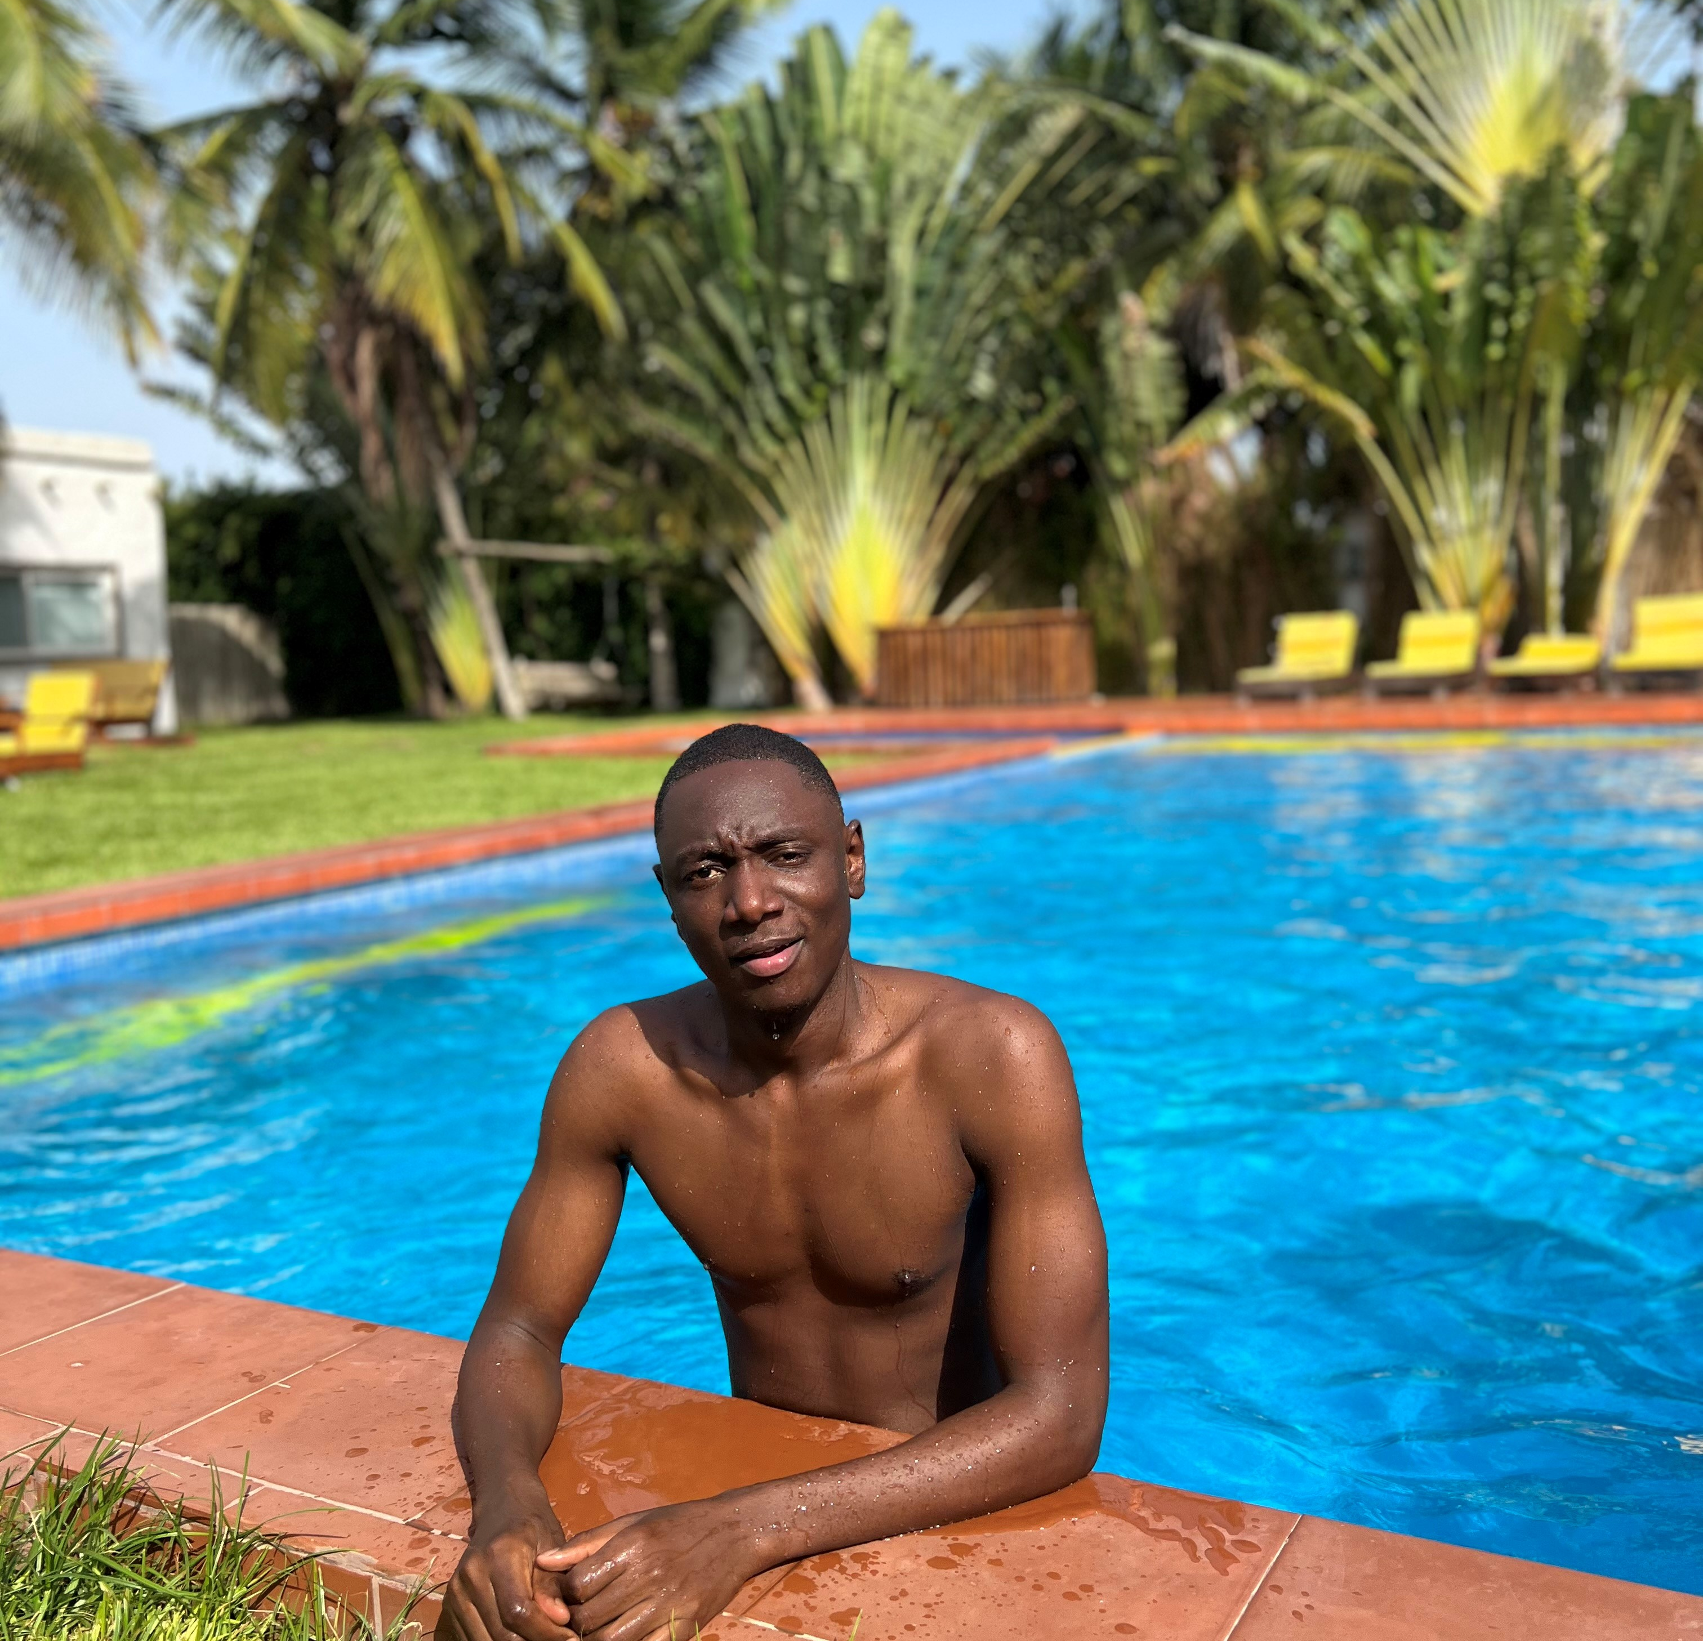
Getting to Know Me
Work
Personal
My role
Regional Digital Apps Delivery, Deployment, Adoption and Support Lead - Africa
Significant others / family members / furry friends in my life
N/A
Tenure in ofi/Olam
8
How I enjoy spending my free time
Listening to Music
Previous companies I have worked at
N/A
My favorite / comfort food
Fufu with light soup
Why I joined ofi/Olam and what keeps me here?
Global exposure, opportunities, Innovation & transformation
My favorite song
Non-Stop by Stonebwoy
Obed Alhassan
‘what name you prefer to be called’: Obed
A few fun facts about me
I love singing
This is me outside work, doing stuff I enjoy in my life …

